Slide 2
Have Your Pi and Eat It Too: .NET Core on Raspberry Pi
Cam Soper
Microsoft

Slide 3
The Berry Beginning

Slide 4
Demo – Building, Deployment, and Debugging

Slide 5
Putting the “Things” in IoT

Slide 6
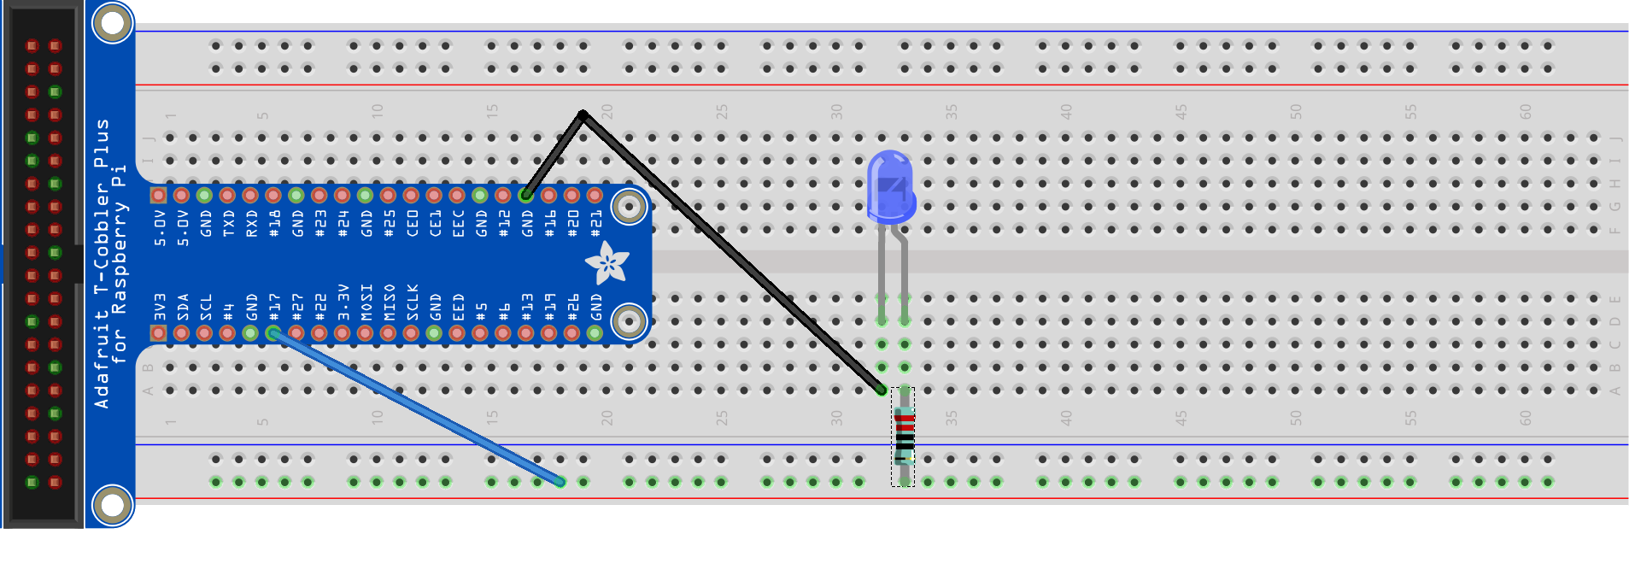
Hello World (LED)
Ground
GPIO 17

Slide 7
Demo - Hello World (LED)

Slide 8
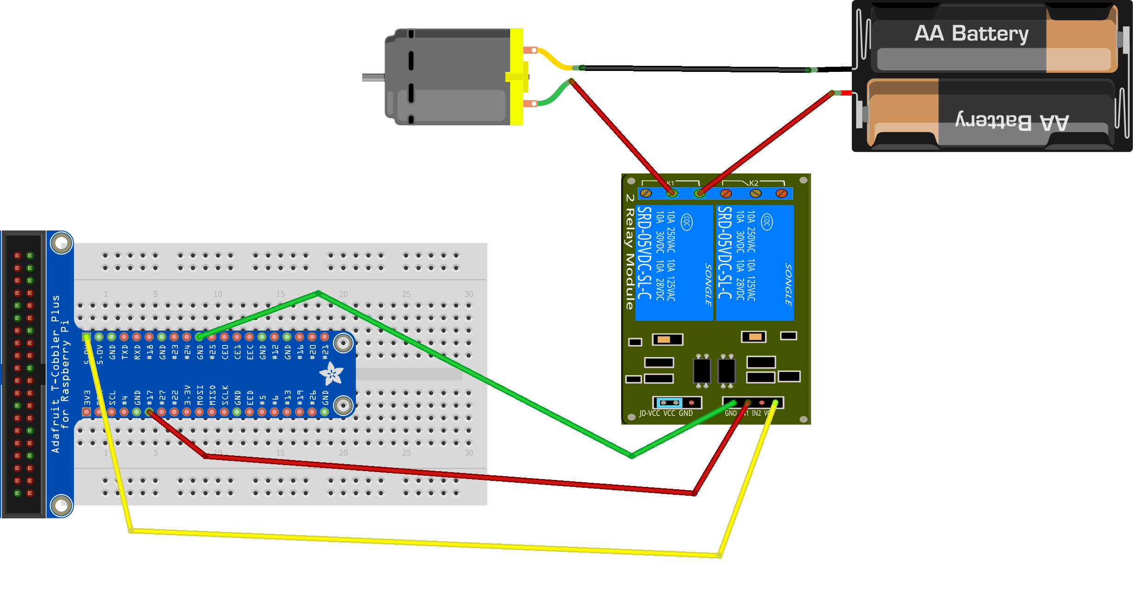
Hello World (Motor)
Ground
GPIO 17
5V

Slide 9
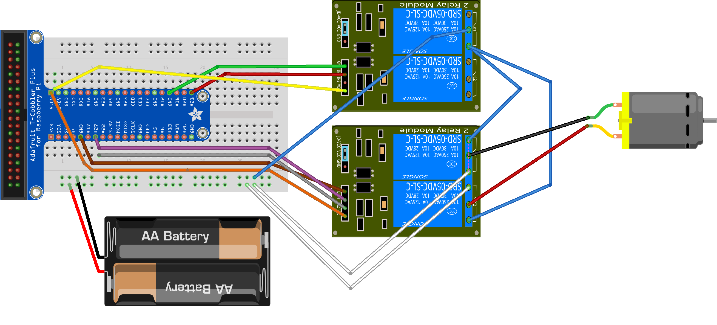












Reversible Motor
GPIO 21
Positive
Negative
Negative
Positive
GPIO 27

Slide 10
Demo - Motors

Slide 11
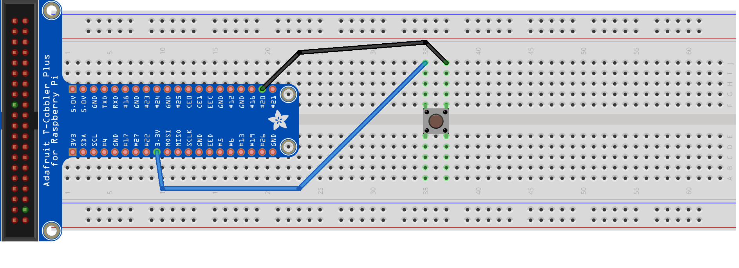
Push Button
GPIO 20
3.3 V

Slide 12
Demo – Push Button

Slide 13
What’s IoT without the Internet?

Slide 14
Demo – Door Sensor Alerts

Slide 15

Build Status Indicator

Slide 16
Demo – Build Status Indicator

Slide 17

Cortana Integration
Hey, Cortana…

Slide 18
Demo – Cortana

Slide 19
What’s next?

Slide 20
What to look at next
https://github.com/camsoper/have-your-pi
System.Devices.Gpio
Prerelease, targeted for .NET Core 3.0
API surface is likely to change
Designed for several IoT platforms (Raspberry Pi included)
Supports all the functionality demonstrated here, but adds support for:
PWM
SPI
I2C
The team is looking for contributors! Visit: http://github.com/dotnet/corefxlab

Slide 21
Questions?

Slide 22


Thank you! @CamSoper CamSoper

